Slide 1
Netflix’s brand
Sophia Considine

Slide 2
Netflix overview

Slide 3
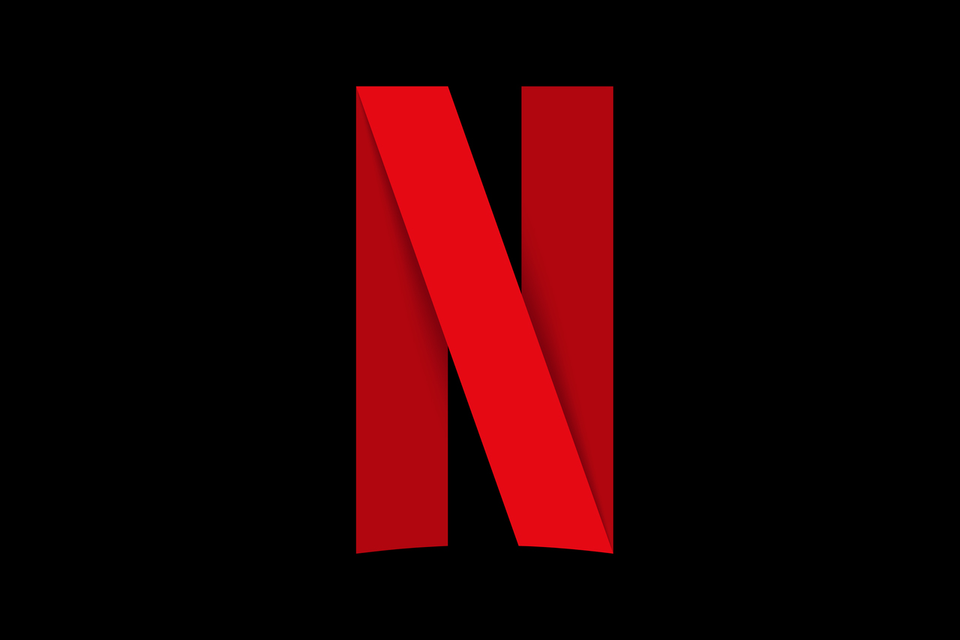
ABOUT NETFLIX:
Netflix is a streaming service company first founded in 1998 by Reed Hastings and Marc Randolph, originally as a DVD delivery rental subscription service. Now, it has over 200 million subscribers, offering an ad-free subscription and one with ads for a lower cost. They stream in over 30 languages and 190 countries.
THE BRAND:
“Stories move us. They make us feel more emotion, see new perspectives, and bring us closer to each other.”
- About Netflix - Homepage

Slide 4
Netflix anthem 2021:
“One story away”
https://adage.com/creativity/work/netflix-launches-one-story-away-new-global-brand-campaign/2379391

Slide 5
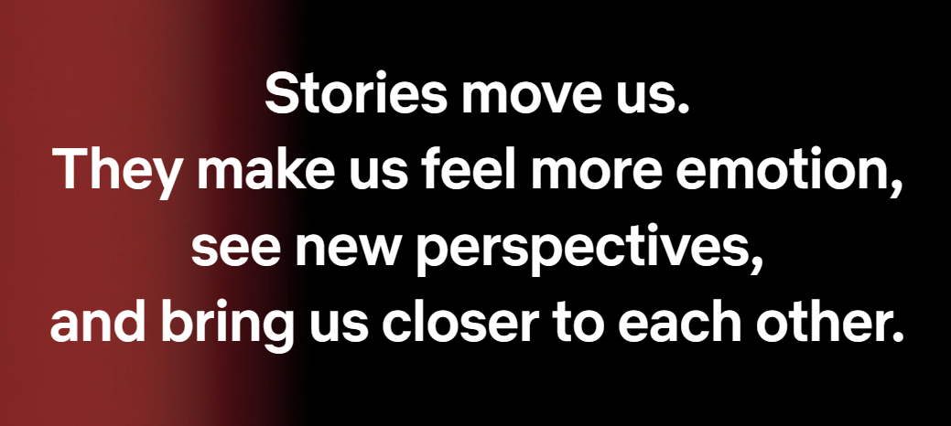
Is it on-brand?
Yes!
Stories
Emotion
Perspectives
Together
Credit: About Netflix - Homepage

Slide 6
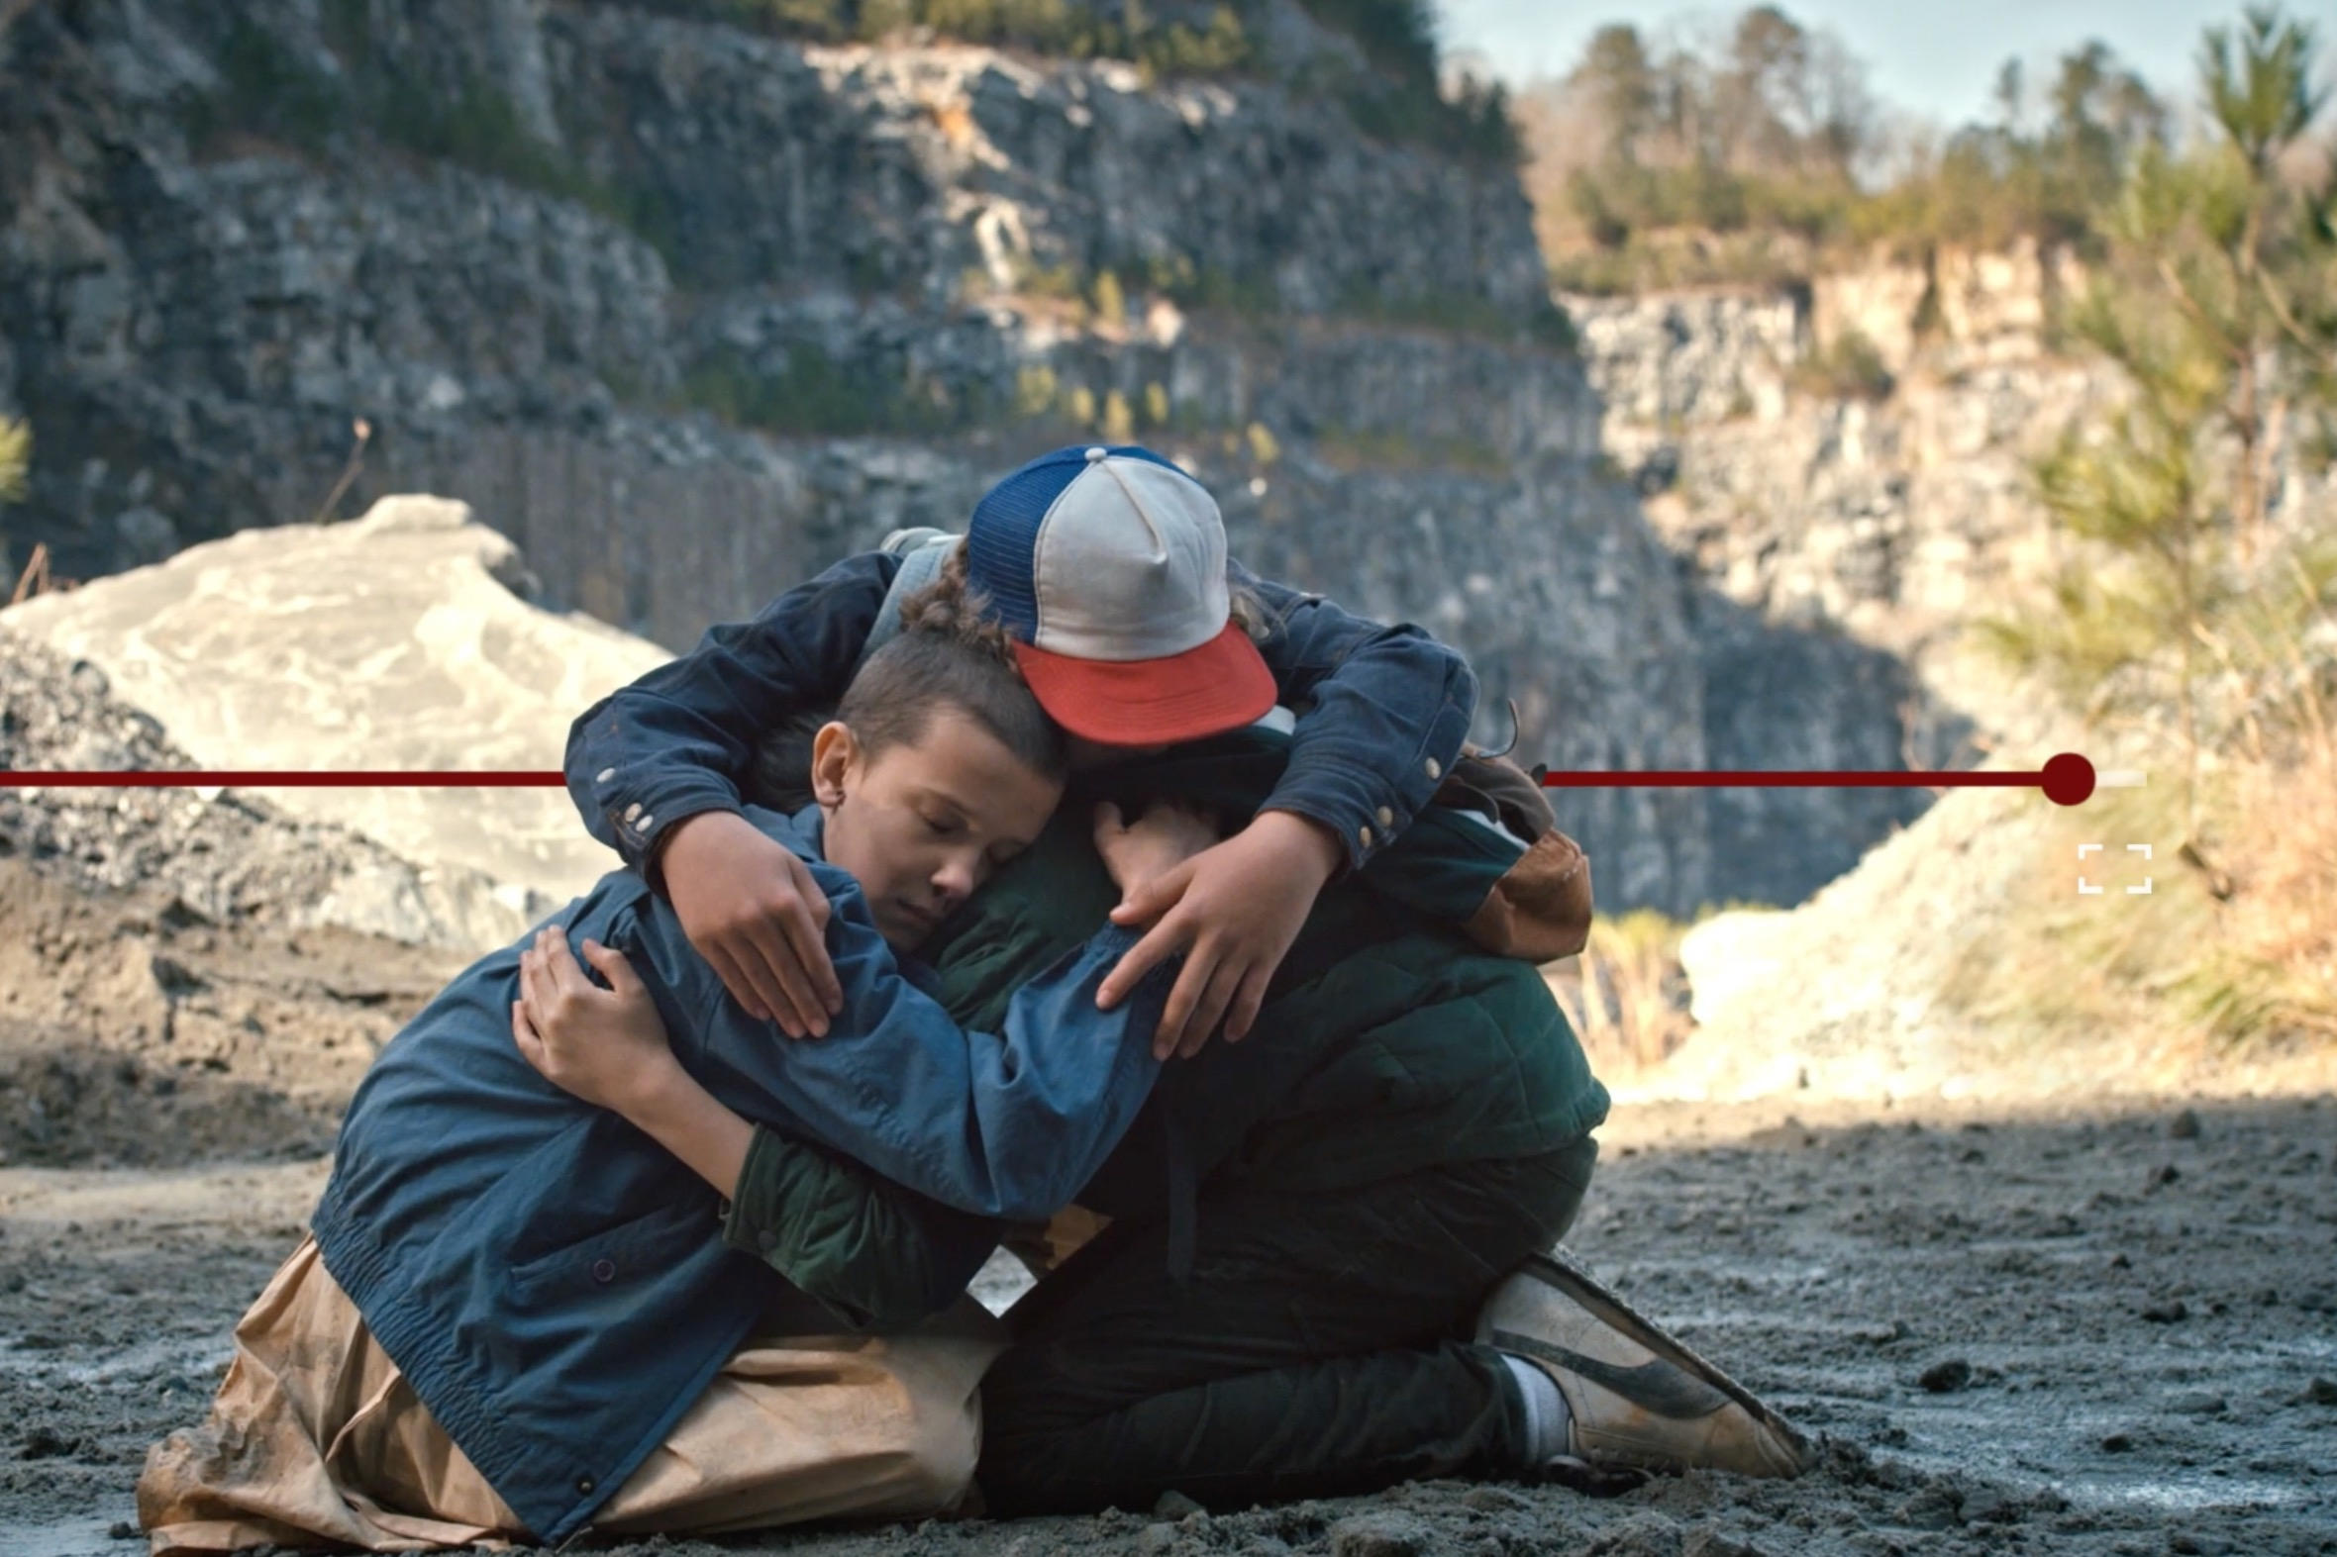
EMOTIONAL CONNECTION?
Yes!
Music
Voiceover
Scenes from their movies / shows / documentaries
Credit: Netflix Launches 'One Story Away,' a New Global Brand Campaign | Ad Age

Slide 7
Social media

Slide 8
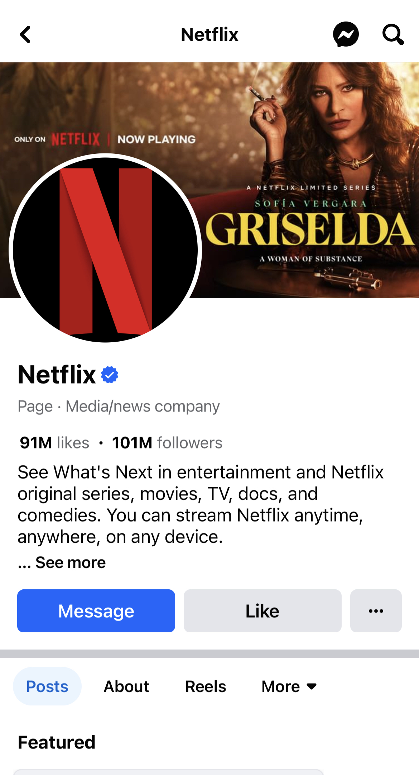
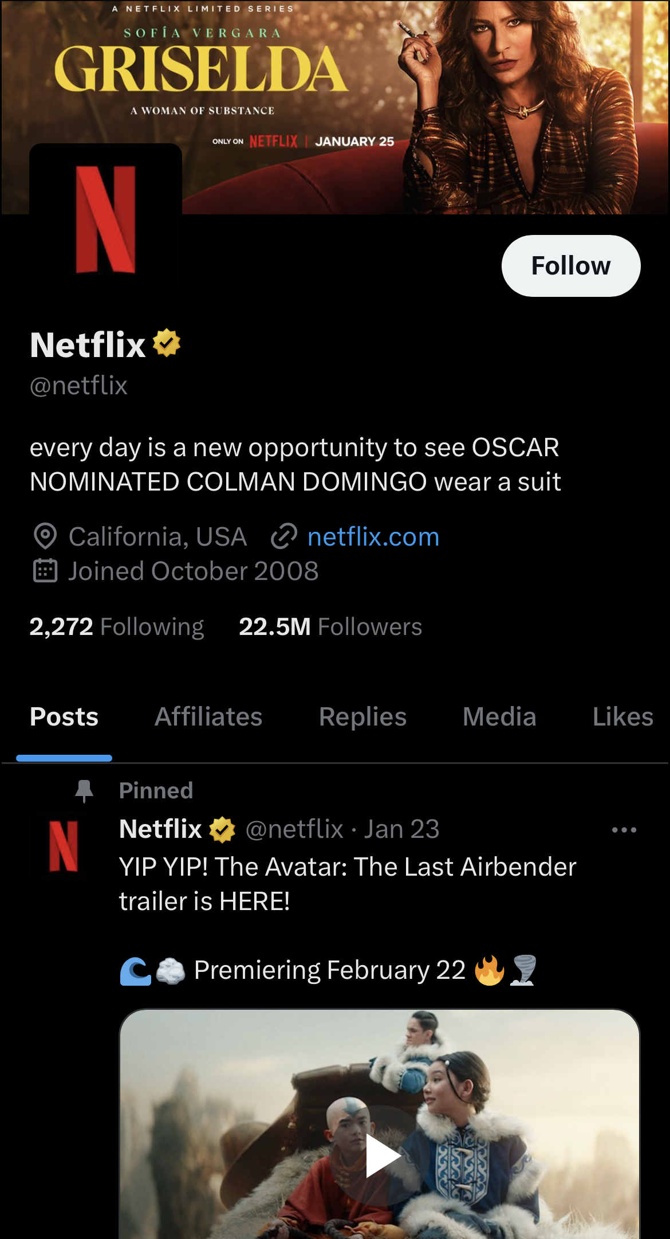
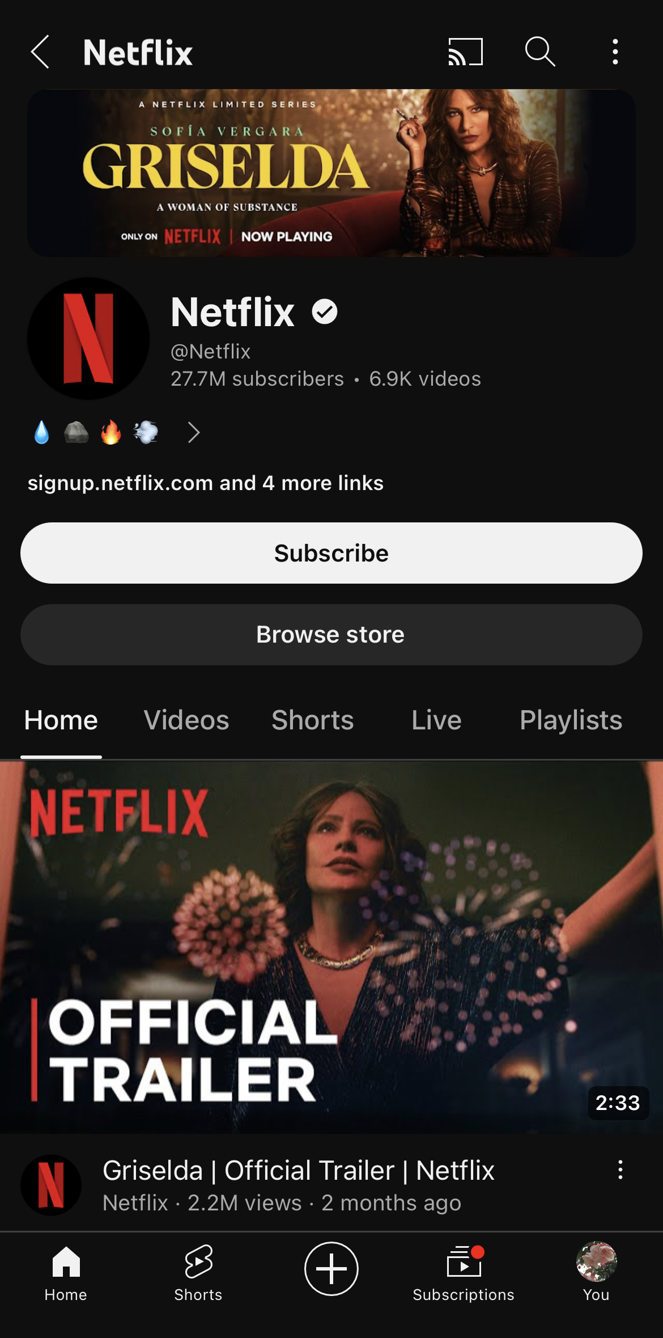
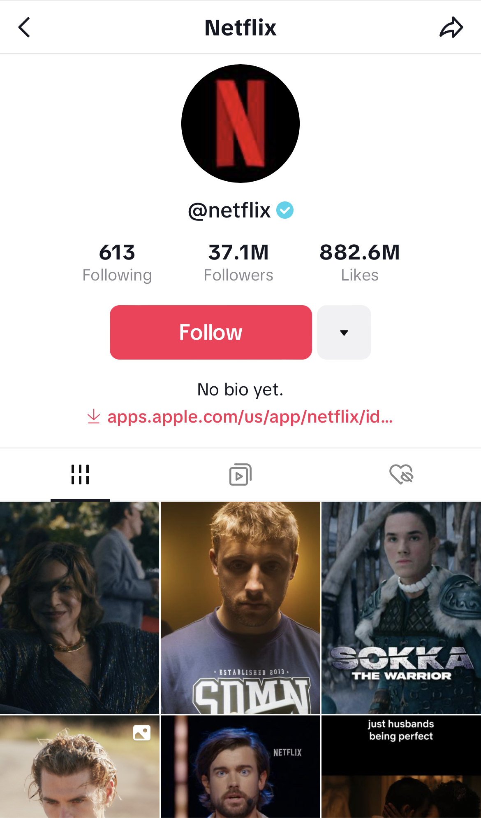
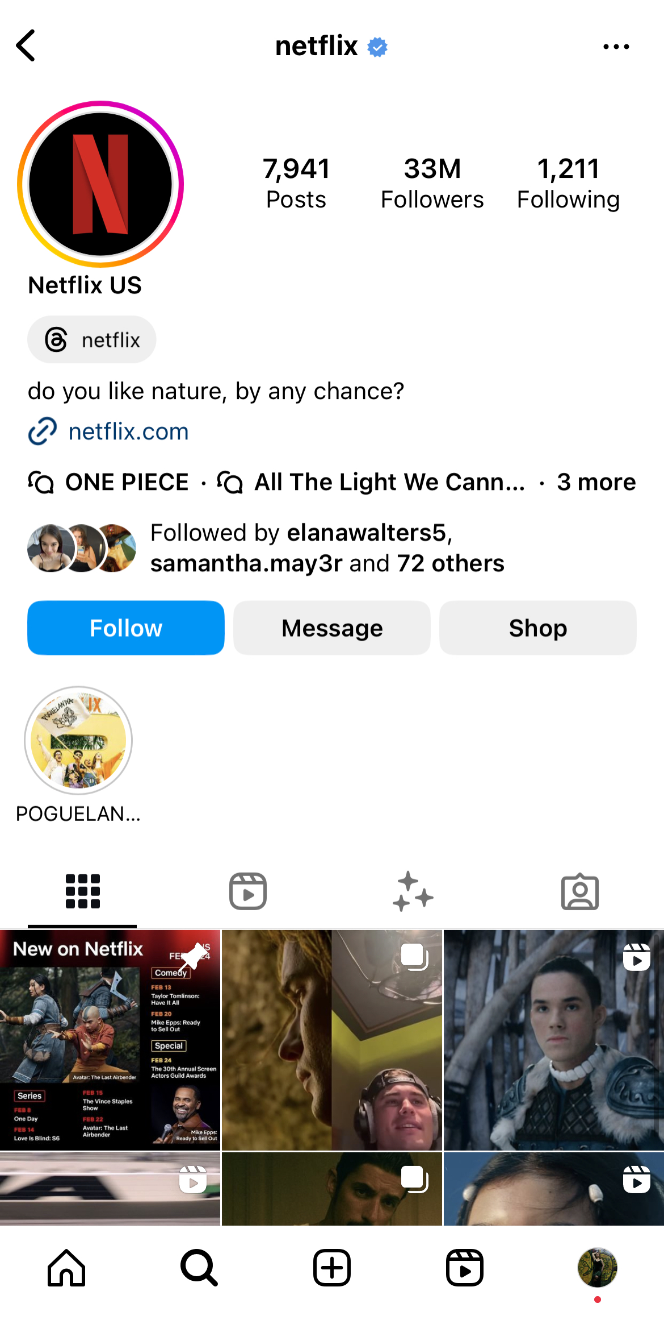
Facebook:
101M followers
YouTube:
27.6M subscribers
Instagram:
33M followers
Twitter (X):
22.5M followers
TikTok:
36.9M followers

Slide 9

Thank you

